Slide 1

Architecting Programmable Data Plane Defenses into the Network with FastFlex
Jiarong Xing, Wenqing Wu, Ang Chen
Rice University

Slide 2










Motivation: Mitigating network attacks
Global DNS outage
hits Microsoft Azure customers
'Internet Of Things' hacking attack led to widespread outage of popular websites
Amazon.com goes down, loses $66,240 per minute
Power grid cyber attacks keep the Pentagon up at night
The world’s largest DDoS attack took GitHub offline for fewer than 10 minutes
Hacked home devices caused massive Internet outage
Cyberattacks: Stuxnet and Flame
Incapsula estimates DDoS attacks cost $40,000 per hour
Equifax is still paying for its data breach: $1.4 billion and counting
Internet shutdowns cost countries $2.4 billion last year
Attacks are increasing and they are getting more advanced
Needle-in-a-haystack attacks (e.g., data exfiltration)
Volumetric attacks (e.g., DDoS)
Dynamic changing attacks (e.g., Link-flooding)
…
We need programmable defenses!

Slide 3




State of the art: OpenFlow-based SDN defenses
SPIFFY(NDSS’16)
SDN controller
PBS(NDSS’16)
vNIDS(CCS’18)
…
Responses
Aggregate/Sampled data
SDN switch
SDN switch
Defense apps run on the central controller.
Switches send sampled traffic to the controller.
The controller makes defense decisions.

Slide 4
Limitations of OpenFlow-based SDN defenses
Can only handle sampled traffic
May miss needle-in-a-haystack attacks
Make decisions with high latency
Would fall behind of fast dynamic changing attacks
The central controller might become the bottleneck
Vulnerable to saturation attacks (e.g. Avant-guard CCS’13)
Key reason: Can only program the central controller

Slide 5
New opportunity: Programmable data planes
Switch control plane
Programmable
Parser
PCIe bus
Programmable
Deparser
Memory
ALU
Match/
Action
Table
Match/
Action
Table
Stages
Stages
Match/
Action
Table
Programmable data planes
Can be programmed in high-level languages (e.g., P4)
Customized protocols, persistent state, custom match/actions
All at linespeed (Tbps)!

Slide 6
This is great news for security!
Per-packet visibility
Can detect needle-in-a-haystack attacks
Per-packet dynamicity
Can respond as fast as dynamic changing attacks
Scale-free defense
Naturally scales with network size and speed
Three key
advantages

Slide 7
Vision: Programmable in-network security
Programmable In-network security:
Deploys a wide range of defenses in-network
Synchronizes them for whole-network defense!
Simultaneous routing and security!
We believe this is achievable in two steps

Slide 8


Vision: A switch is a defense platform
Security ”apps”
Runs a wide range of security apps
Dynamically swaps in the right app as it forwards traffic.
Work: NetHide (USENIX Security’18), Heavy Hitter Detection (SOSR’18), Poise (USENIX Security’20), …

Slide 9




Vision: A network is a defense fleet
A
C
E
D
F
B
Architect a wide range of defenses into network paths
Networks mitigate attacks as they route traffic
Focus of FastFlex

Slide 10
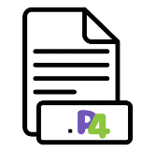


Approach: FastFlex
Joint analysis of all apps
(b) Generate optimal deployment
(c) Distributed control

Slide 11

Outline
Motivation: Mitigating network attacks
State of the art: SDN defenses
Approach: FastFlex
Resource multiplexing
Optimal placements
Distributed control
Dynamic scaling
Case study: Link-flooding attacks

Slide 12

Challenge #1: Resource multiplexing
Security ”apps”
Problem:
How to deploy multiple applications in a single switch?
How to deploy a large application in a single switch?

Slide 13

Solution: Program decomposition + sharing
A
A
A
A
B
B
C
B
C
+
C
E
C
E
E
E
D
D
D
G
F
G
F
F
P4 programs
Data flow graphs
Data flow graph
Full data flow graph
Smaller components are easier to pack than larger ones.
Component sharing improves resource utilization.

Slide 14

Challenge #2: Defense placement
Problem: How to find an optimal deployment for a network?

Slide 15
Opportunity: Pervasive distribution
A
B
G
A
B
C
+
E
E
C
F
B
D
G
D
F
Full data flow graph
Network topology
Network deployment
Existing methods in placing middleboxes, e.g. FlowTags (NSDI’14), etc.
Key difference: Pervasive distribution
Reduces traffic detour
Prevents hotspots from forming

Slide 16
Challenge #3: Distributed control
SDN controller
SDN switch
SDN switch
Problem: How to synchronize switches entirely in the data plane?

Slide 17
Solution: Distributed data plane probes
P4 switch
P4 switch
Using data plane probes to communicate with other switches

Slide 18
Challenge #4: Unpredictable attack patterns
G
B
A
E
B
C
F
D
Problem: How to handle unpredictable attacks patterns?

Slide 19
Solution: Dynamic scaling
E
G
G
B
B
A
A
E
E
C
F
B
C
F
B
D
D
Dynamic scaling up and down
State migration across switches
Handling fault tolerance, e.g. forward error correction
Updating routing rules of upstream switches

Slide 20
Outline
Motivation: Mitigating network attacks
State of the art: SDN defenses
Approach: FastFlex
Resource multiplexing
Optimal placements
Distributed control
Dynamic scaling
Case study: Link-flooding attacks

Slide 21


Case study: Link-flooding defense
Can congest critical links to cut off victims from the network.
Can dynamically change target links

Slide 22

State-of-the-art: Traffic rerouting with SDNs
SDN controller
Find alternative routes by the central controller, e.g. SPIFFY(NDSS’16).
Reroute traffic to alleviate congestion on the target link.

Slide 23
Our defense: Traffic rerouting with FastFlex
Find alternative routes by probes on data plane in a distributed manner.
See more defenses in our paper!

Slide 24
Experimental setup
Proof-of-concept prototype:
Runs in ns3 + P4 bmv2.
Scenario:
Two critical links in the topology
The attacker dynamically changes her target links.
Baseline:
An SDN-based defense that performs centralized TE to reconfigure the network. (SPIFFY, NDSS’16)

Slide 25
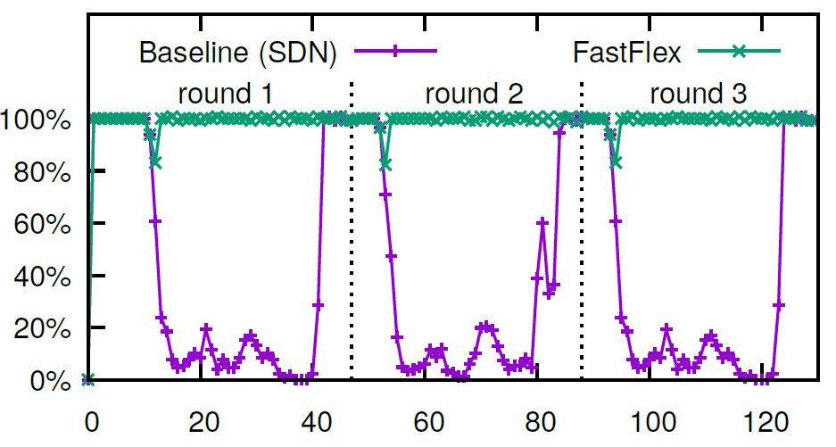
FastFlex mitigates link-flooding attacks effectively
Normalized throughput
Time (seconds)
The SDN defense: Constantly falls behind.
FastFlex: Disperses the traffic almost instantaneously.

Slide 26
Summary
Motivation: Mitigating network attacks
Opportunity: Programmable data planes
Three key advantages:
Per-packet visibility
Per-packet dynamicity
Scale free defense
Vision: Programmable in-network security
A switch as a defense platform
A network as a defense fleet
Thanks!

